Slide 1


Business Optimization
Using NLP to improve a businesses understanding of the market

Slide 2
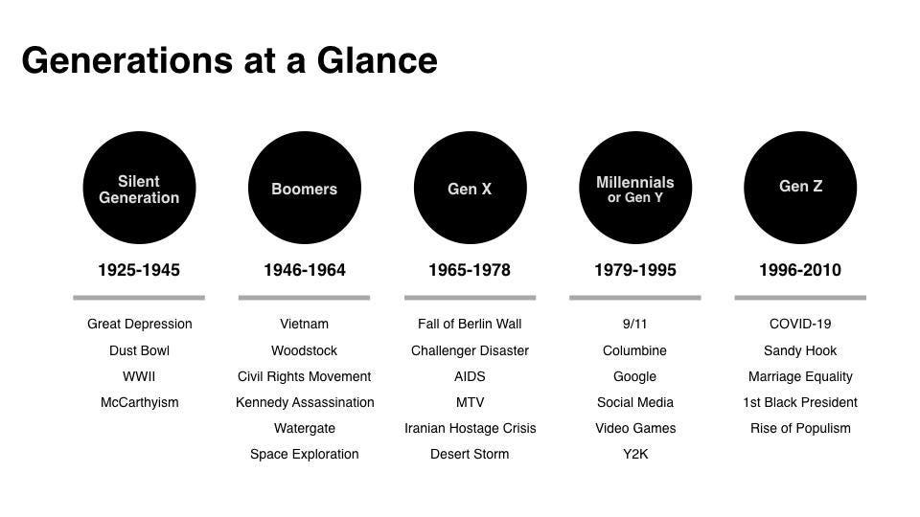
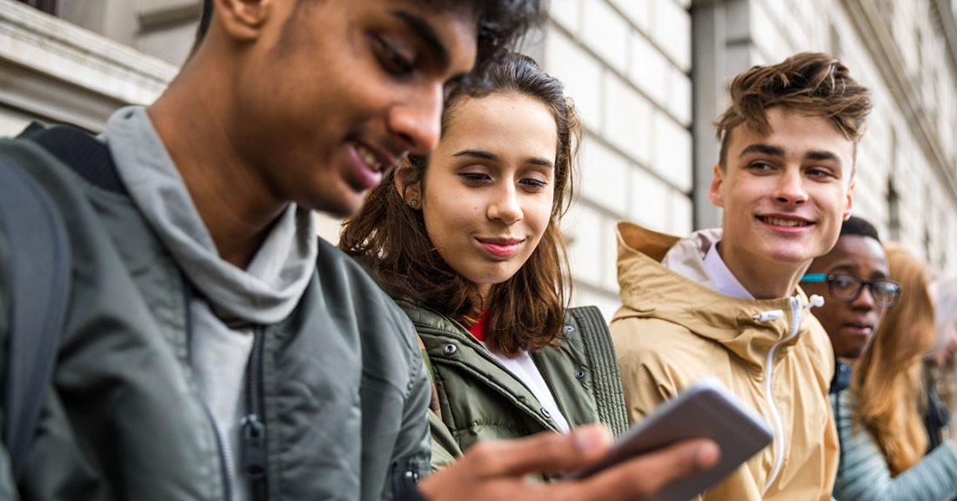
What is the problem?
New generation = New environments = New behavioral patterns
∴ we need to understand customers purchasing behaviour

Slide 3
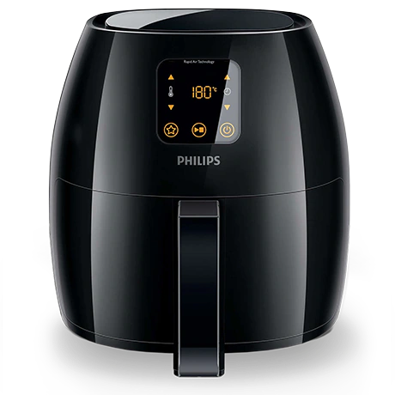
The way forward…
There are heaps of untapped data which we can use to gain insights into customer behaviors, spending patterns and trending products
Example: Air Fryer
Been around for 10 years
Recently gained popularity
Companies improve their air-fryer models with new features such as led screens and automatic cooking functions

Slide 4
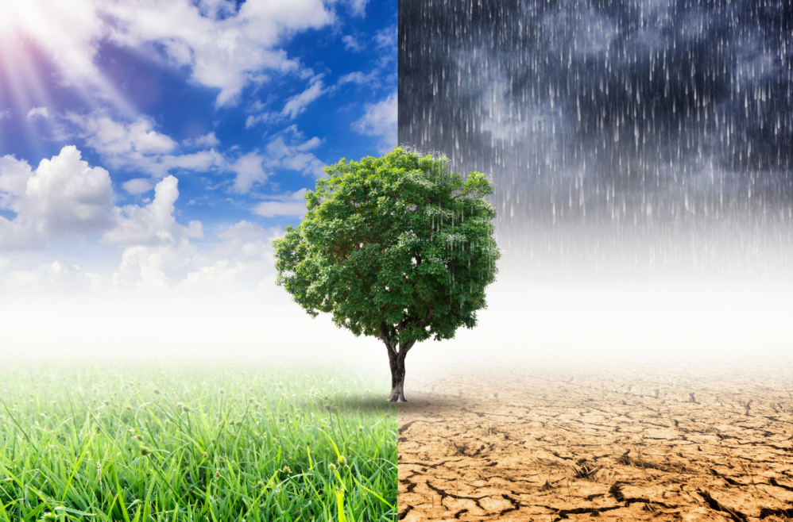
Problem Statement
We would like to determine how people perceive climate change and whether or not they perceive it is a real threat.

Slide 5

Climate Change Sentiment Indicator
Data Collected = Tweets
Main Objective: Create a Machine Learning model that is able to classify a persons sentiment.
No. Assigned | SENTIMENT
1 | Supports the belief of man-made climate change
-1 | Does not believe in man-made climate change
0 | Neither supports nor refutes the belief of man-made climate change
2 | The tweet links to factual news about climate change

Slide 6
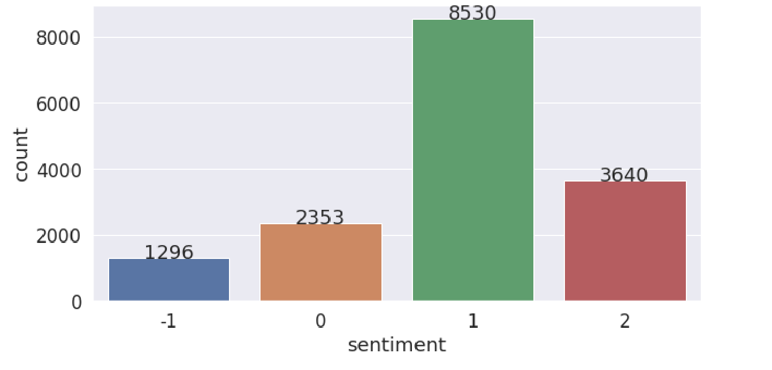
Exploratory Data Analysis
No. assigned | SENTIMENT
1 | Supports the belief of man-made climate change
-1 | Does not believe in man-made climate change
0 | Neither supports nor refutes the belief of man-made climate change
2 | The tweet links to factual news about climate change

Slide 7
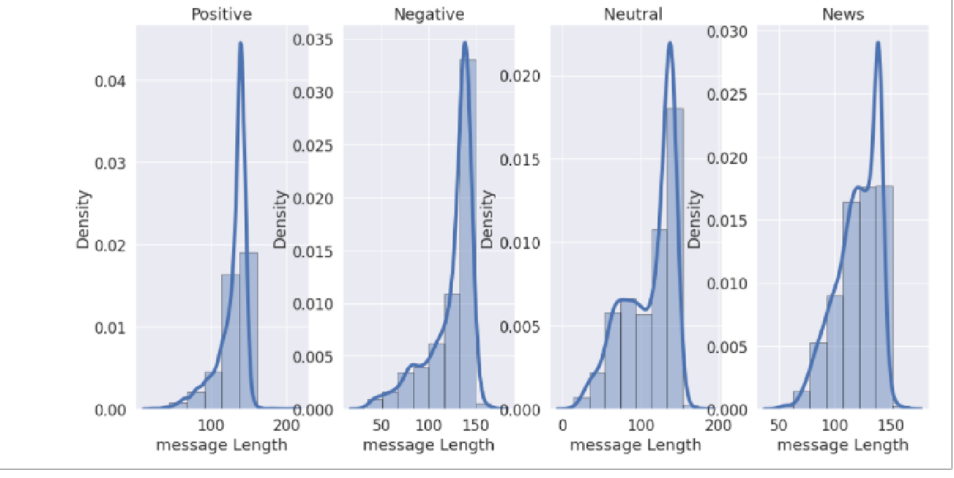
Exploratory Data Analysis
Comparing the length of messages using characters it can be seen that the average length of messages for all sentiments is approximately 140.

Slide 8
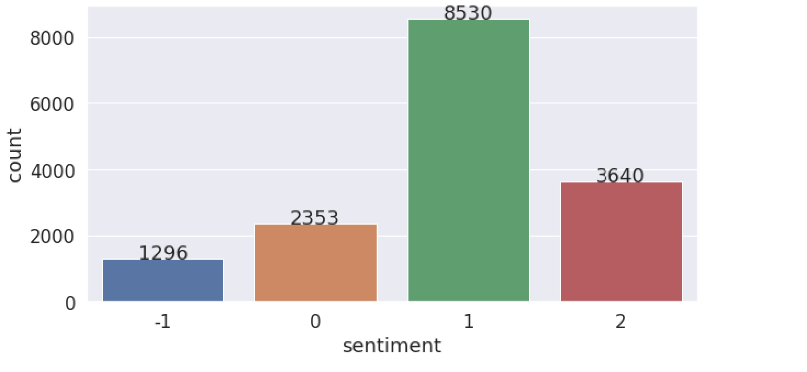
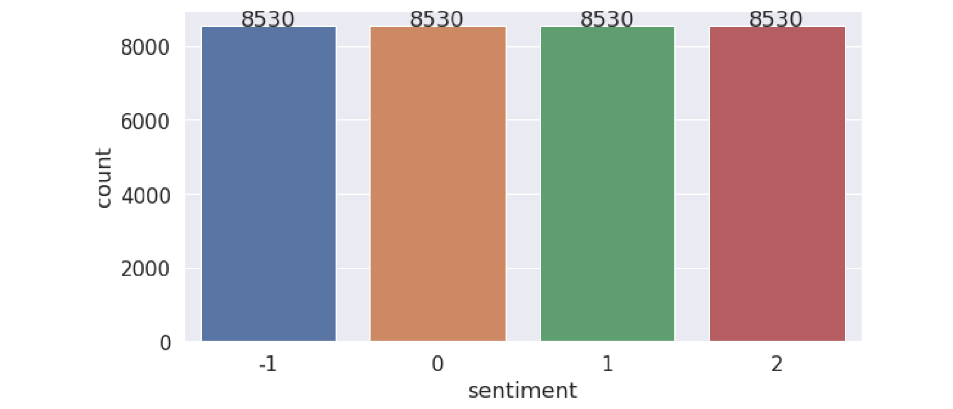
Modeling
Unbalanced to Balanced data

Slide 9
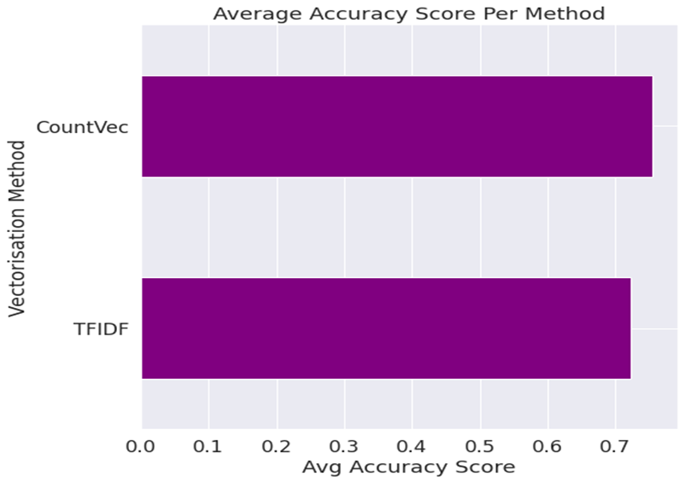

Vectorization methods

Slide 10
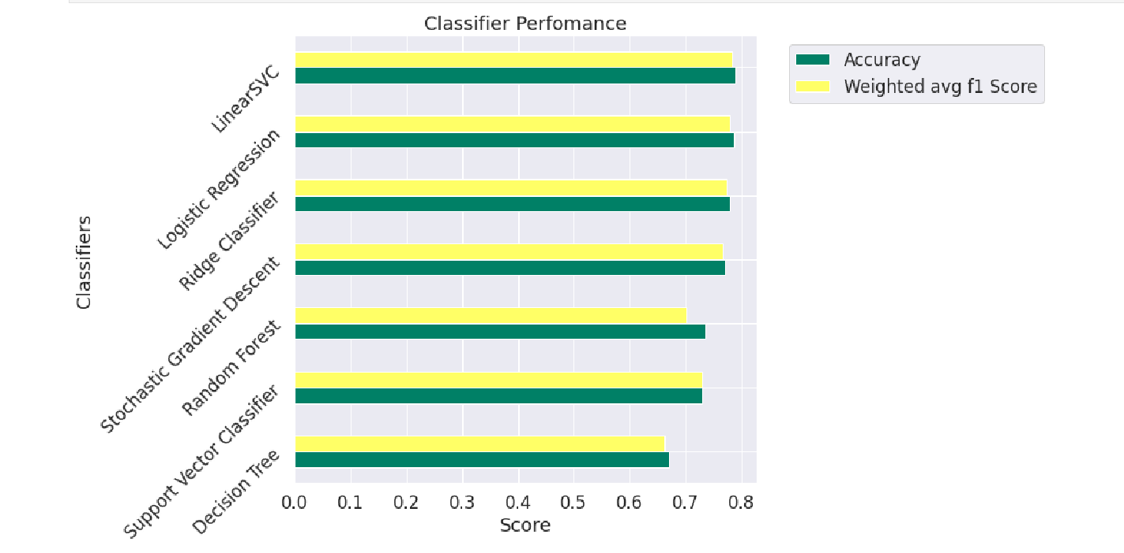
Results From Models

Slide 11
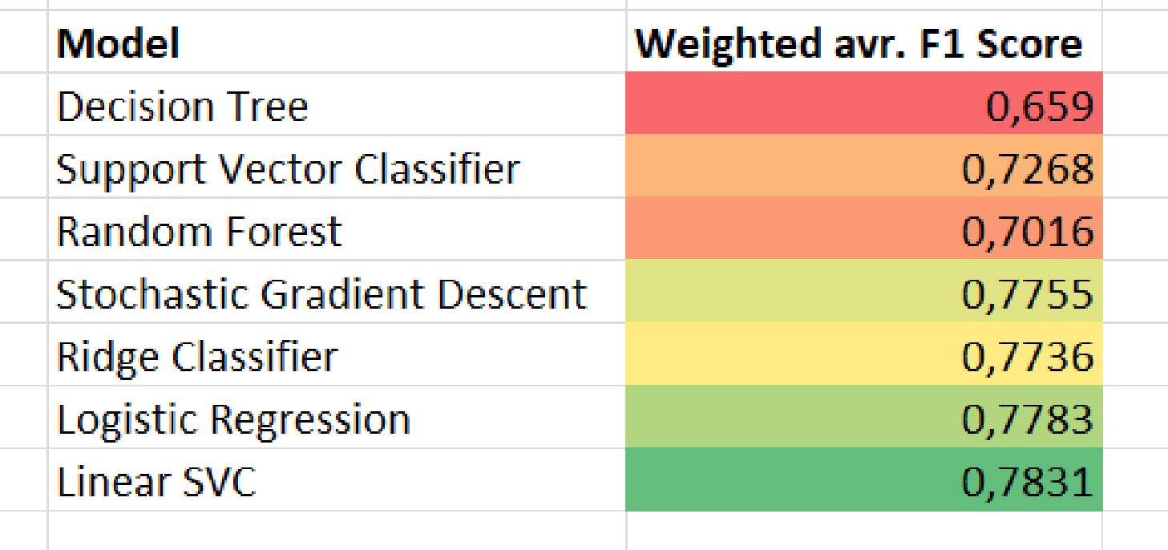


Results from Models
: Represents models chosen for hyperparameter tuning
We then choose the 4 best performing models and uploaded to Kaggle. Thereafter, we picked Ridge Classifier and Logistic Regression to perform Hyperparameter tuning on

Slide 12
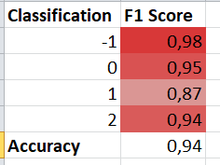
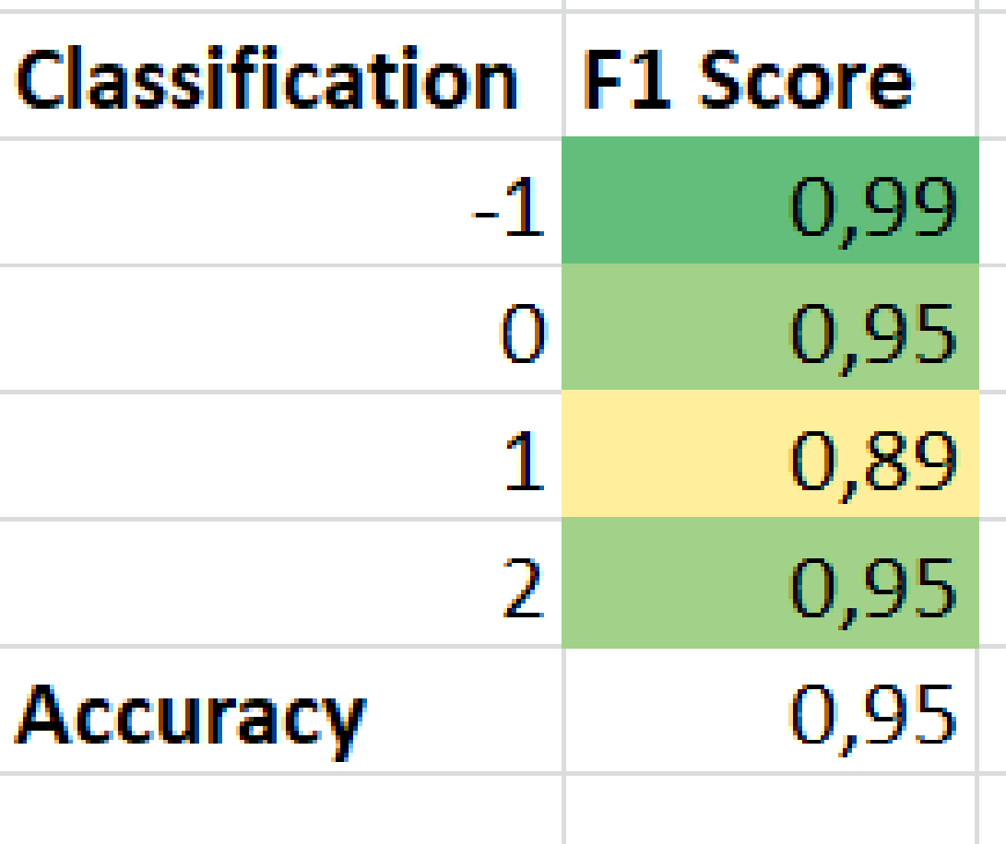
Hyperparameter Tuning Results
Ridge Regression vs. Logistic Regression
Logistic Regression:

Slide 13
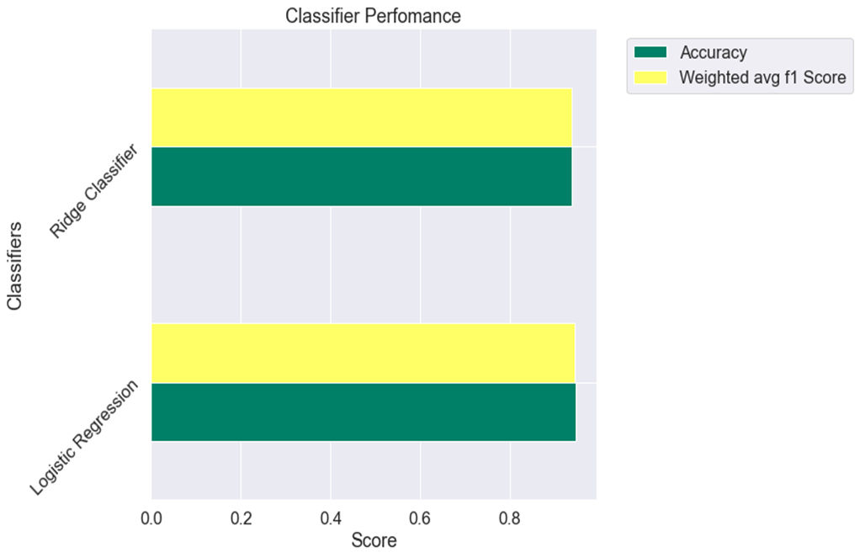
Tuned Ridge and Logistic

Slide 14
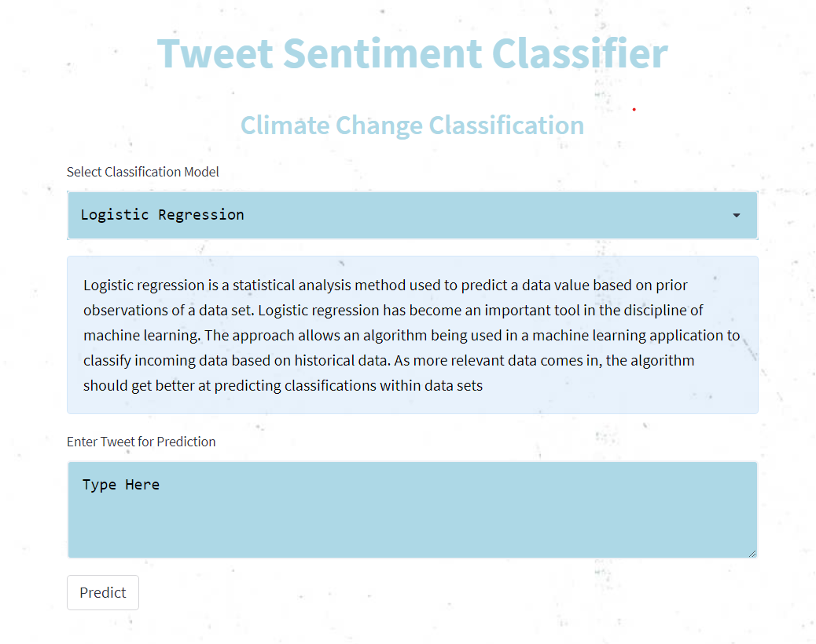
Streamlit

Slide 15
Conclusion
To conclude, a lot of insight can be drawn from analysing people’s social media activities. Therefore, being able to correctly identify and understand these activities is essential in ensuring successful marketing campaigns. As demonstrated, we have successfully created an App that is able to categorise people’s climate change sentiments based of their tweets. This App can provide your company access to a broad base of consumer sentiments, from across the globe. Therefore, increasing your insights and informing your future marketing strategies.

